Slide 1
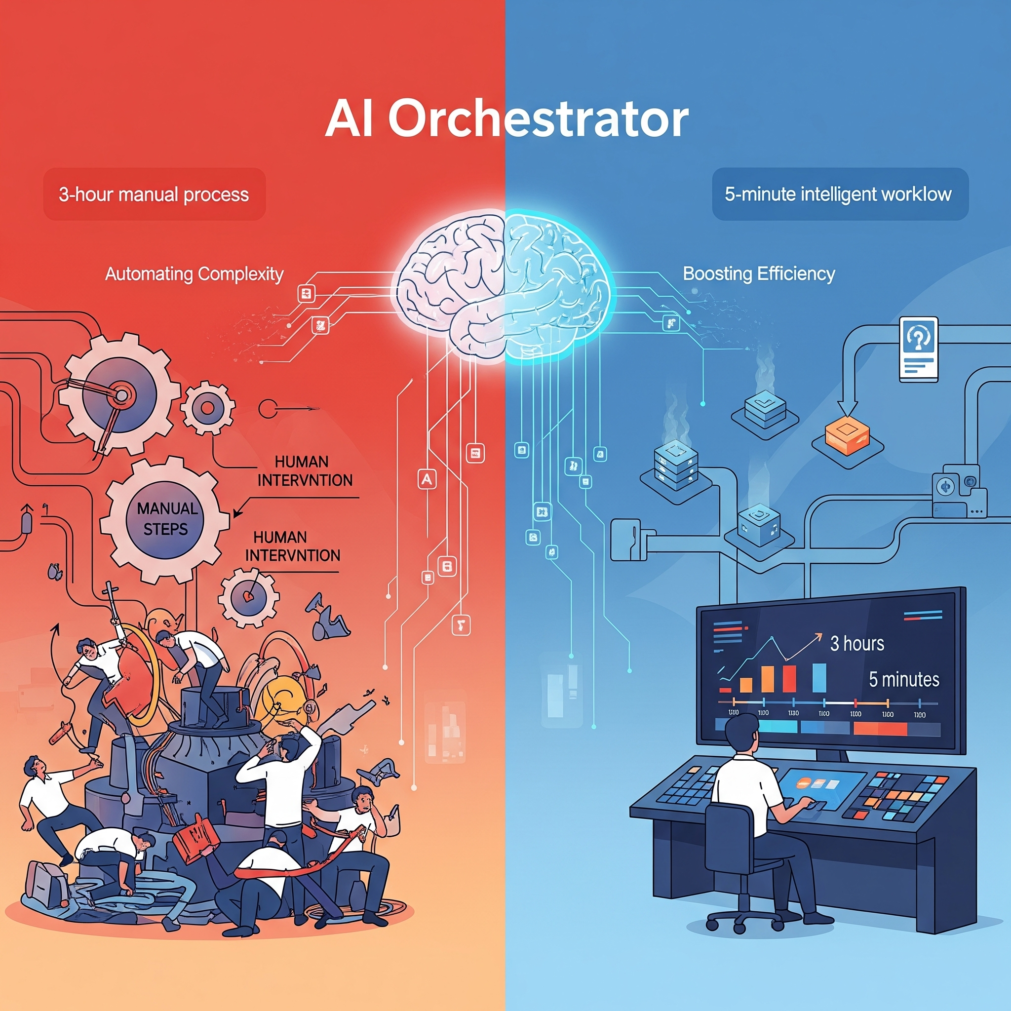
N8n Workflow - AI Onboarding Orchestrator
Joseph Boring - AI Automation Specialist
Sprint 7 - Capstone Project
Transforming a 3-Hour Manual Process into a 5-Minute Intelligent Workflow

Slide 2

The Problem: Manual Onboarding
Onboarding is a critical first impression, but the manual process is broken.
Time Consuming: HR and hiring managers spend an estimated 2-3 hours per new hire on repetitive administrative tasks.
Error-Prone: Manual data entry across multiple systems (email, spreadsheets, task managers) leads to typos, missed steps, and inconsistent information.
Inconsistent Experience: New hires receive a disjointed, impersonal welcome, leading to confusion and a poor first impression.
Delayed Action: Critical tasks like IT account setup are delayed by slow, email-based communication, impacting Day 1 readiness.
ADJUSTED Miro Prototype ← Click

Slide 3
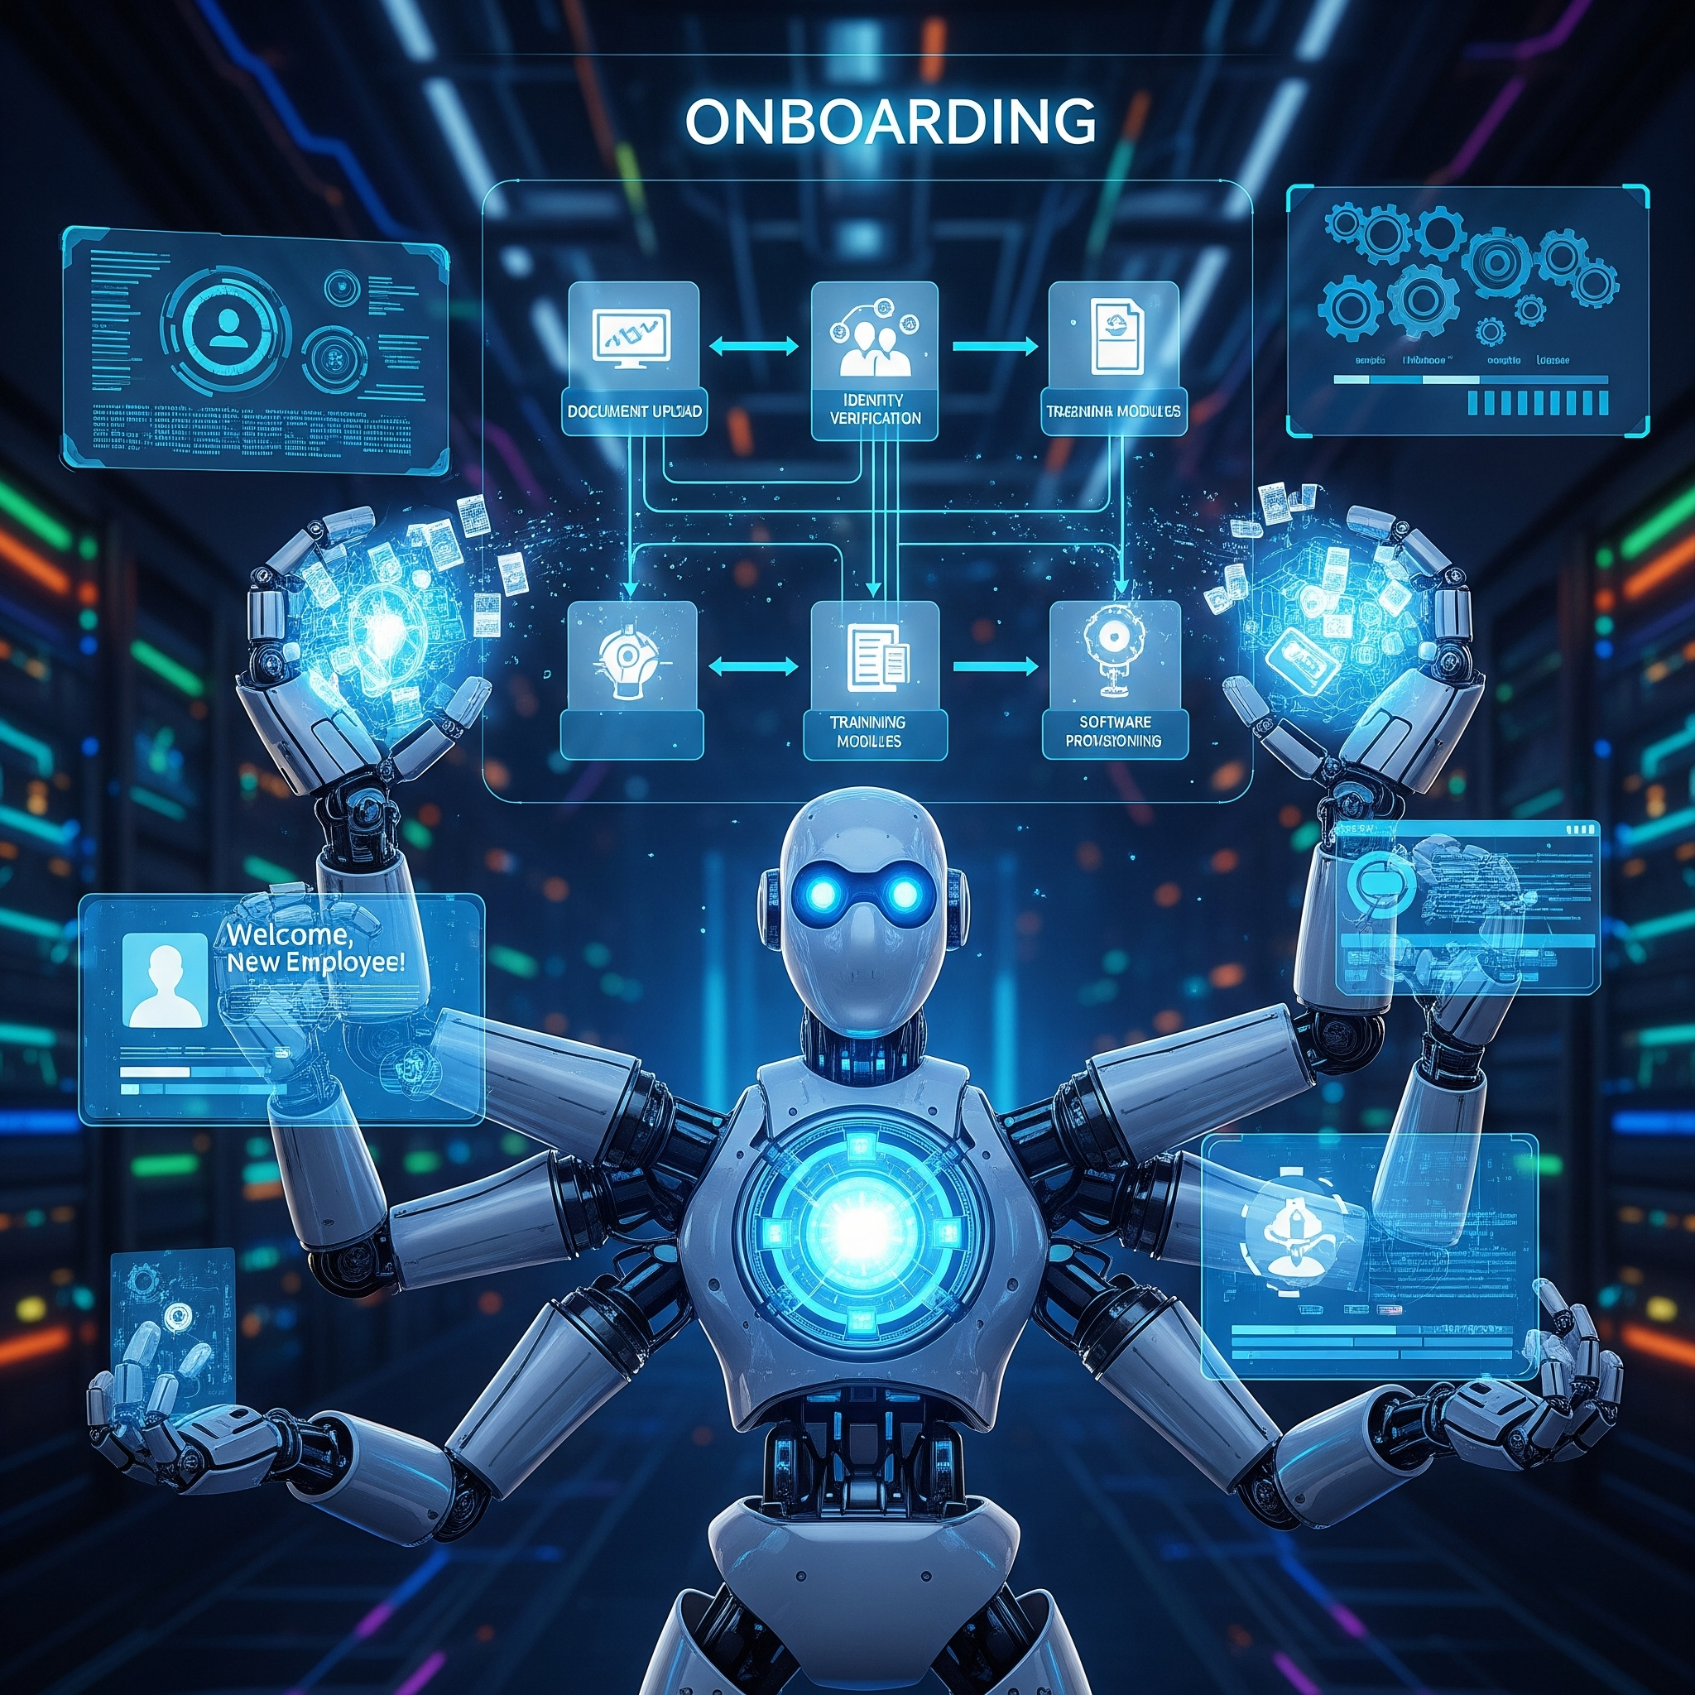
The Solution: Automation Agent
I built an end-to-end automation in n8n to orchestrate the entire onboarding experience.
This solution uses a single form submission to trigger a cascade of intelligent actions, from AI-powered communication to synchronized record-keeping, all without manual intervention.

Slide 4




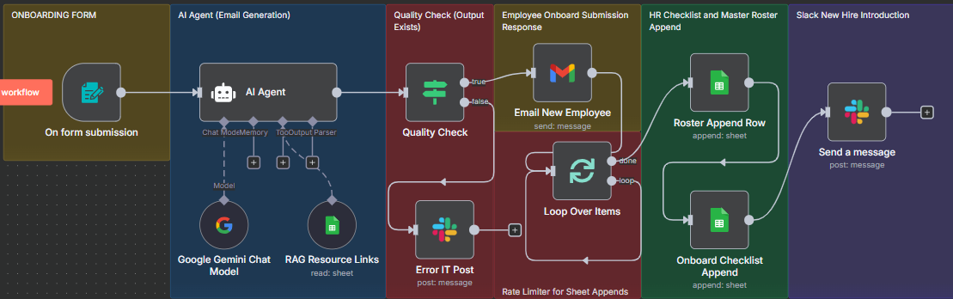
Technical Stack & Workflow Overview
Tech Stack:
Automation Platform: n8n
AI Engine: Google Gemini
Connected Services: Google Sheets, Gmail, Slack
Prototyping: Miro

Slide 5
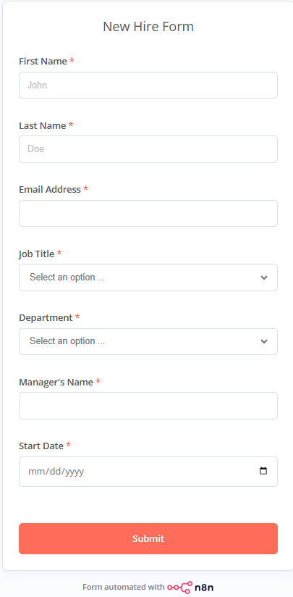
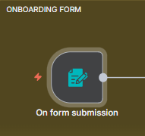
Under The Hood - 1
Single Point of Entry: A simple web form kicks off the entire process.

Slide 6
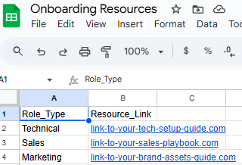
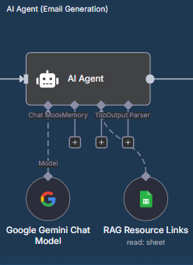
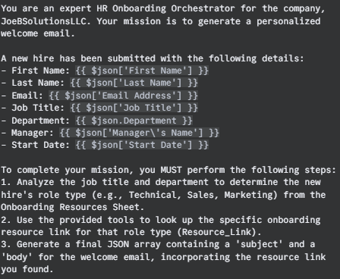
Under The Hood - 2
AI-Powered Personalization: An AI agent analyzes the new hire's role to generate a custom, relevant welcome.
From Generic to Personalized: The agent moves beyond a static template. It retrieves role-specific resources and crafts a unique welcome message for every new hire.
Reduces Cognitive Load: The AI handles the "thinking" part of the process—analyzing the role, finding the right document, and composing the message—freeing up HR to focus on people, not paperwork.
Ensures Consistency: The AI guarantees that every welcome email is high-quality, on-brand, and contains all necessary information, every single time.

Slide 7
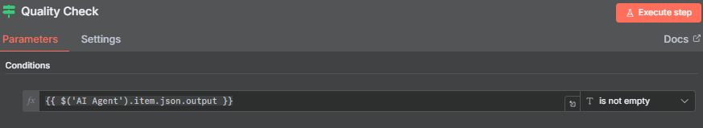
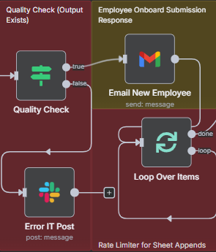
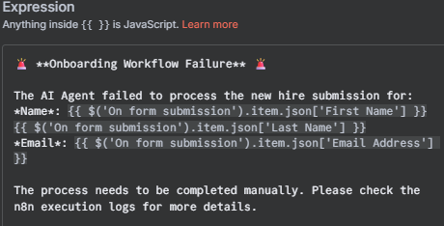
Under The Hood - 3

Slide 8
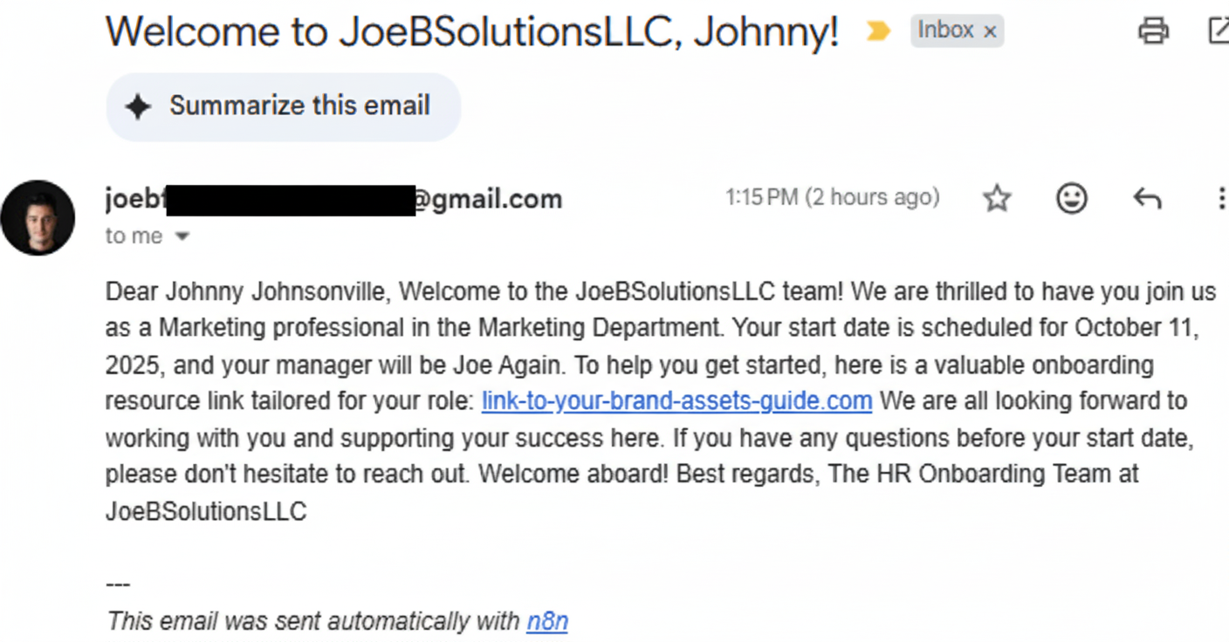
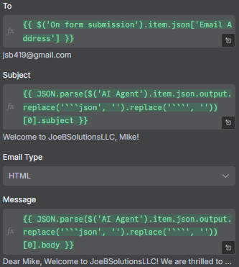
Under The Hood - 3.5
Output: The final welcome email sent to the new hire.

Slide 9
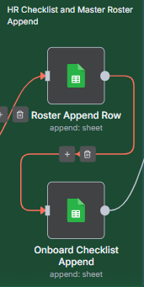
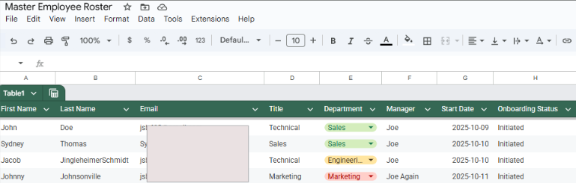
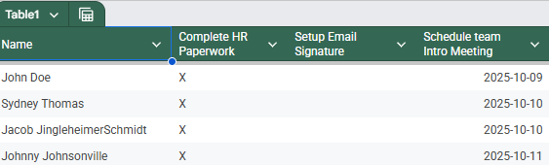
Under The Hood - 4
Synchronized Operations: All records and communications are updated instantly and accurately.

Slide 10
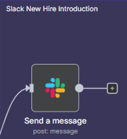
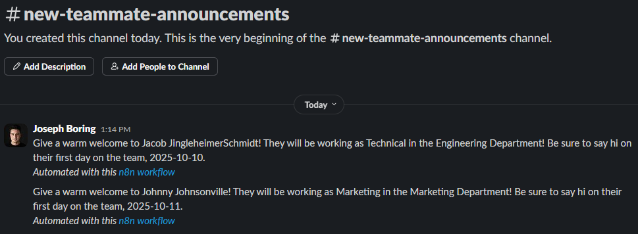
Under The Hood - 5
The automated welcome message posted in the Slack channel.

Slide 11
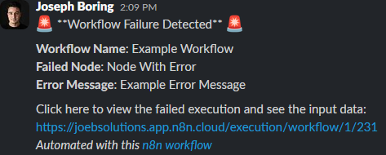
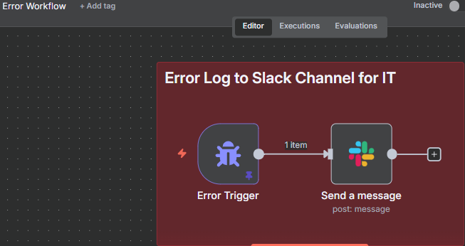
Under The Hood - 6
Robust Error Handling: A dedicated error workflow provides real-time Slack alerts for any failures, ensuring system reliability.

Slide 12
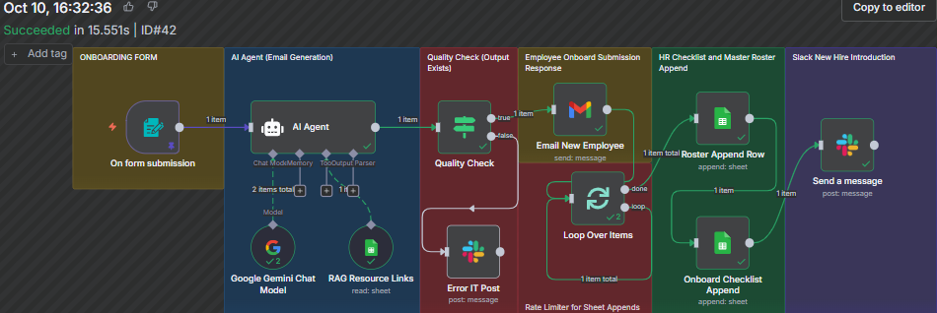
The Results - Tangible Business Value
95%+ Reduction in Manual Work: Transformed a 3-hour process into a 5-minute task.
100% Consistency: Eliminates human error in data entry and communication.
Instantaneous Execution: All steps are completed in seconds, not hours, ensuring Day 1 readiness.

Slide 13
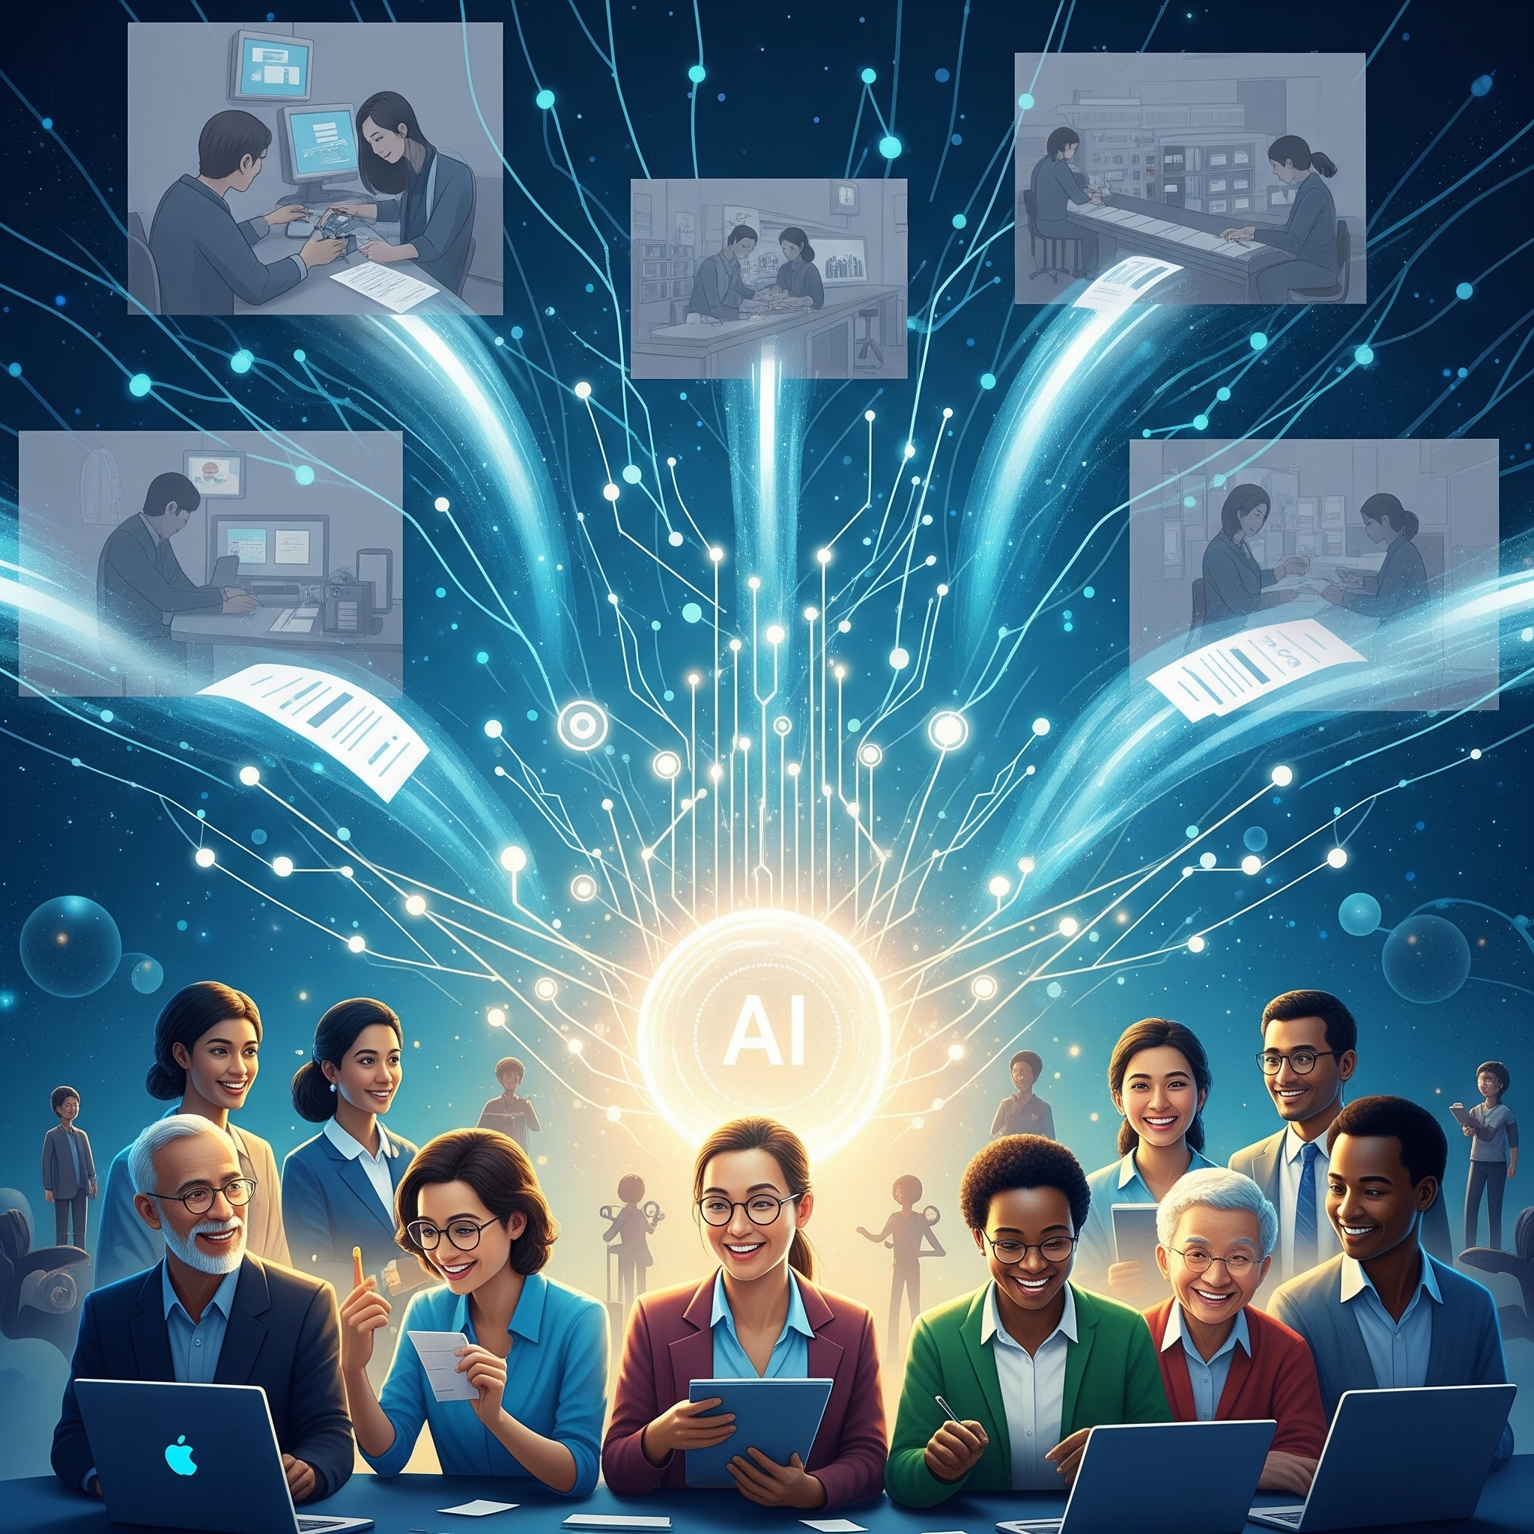
Future Automation: Next Steps
Why this automation matters and where it can go next.
Why It Matters: This project proves that automation isn't about replacing people; it's about empowering them. By eliminating tedious administrative tasks, we give HR and hiring managers back their most valuable resource—time—to focus on the human side of onboarding: mentorship, training, and building connections.
How AI Improved It: The AI agent was the critical component that elevated this from a simple data-entry bot to a truly intelligent system. It introduced personalization and decision-making that a standard, non-AI workflow could never achieve.
Possible Next Steps:
Direct HRIS Integration: Connect directly to systems like Workday or BambooHR to trigger the workflow automatically when a candidate's status changes to "Hired."
Dynamic Checklist Generation: Use the AI agent to dynamically generate the tasks for the onboarding checklist based on the new hire's specific role and seniority.
Automated Calendar Invites: Add a step to automatically schedule a "Welcome Meeting" on the manager's and new hire's calendars.

Slide 14
The End!
**Inputs/Outputs following this slide

Slide 15
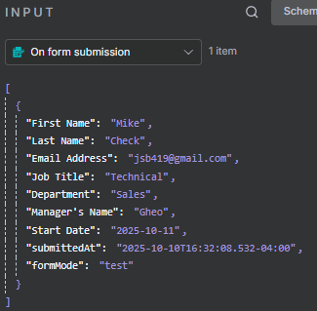
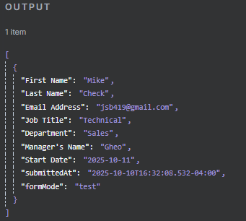
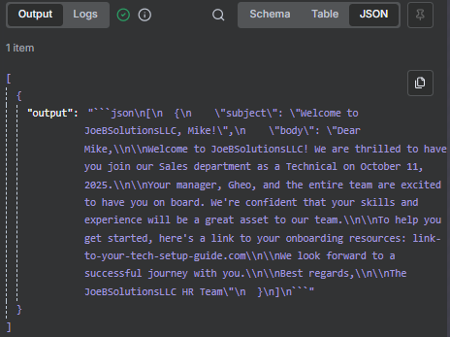
Inputs/Outputs
Form Submission
AI Agent

Slide 16
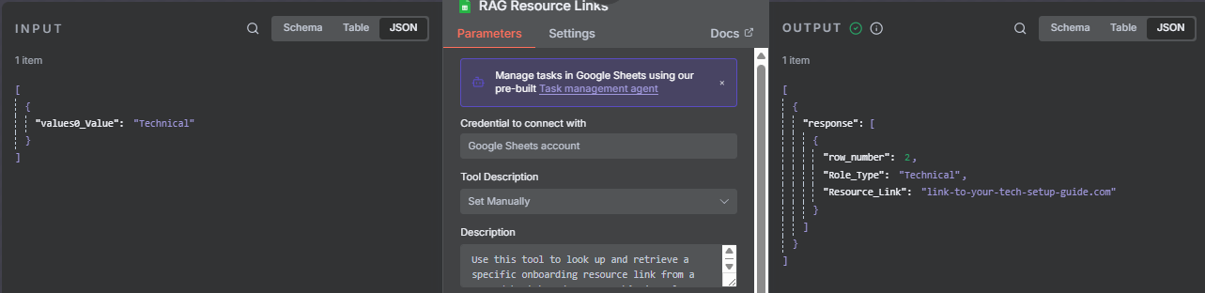
Inputs/Outputs
RAG Agent Tool

Slide 17
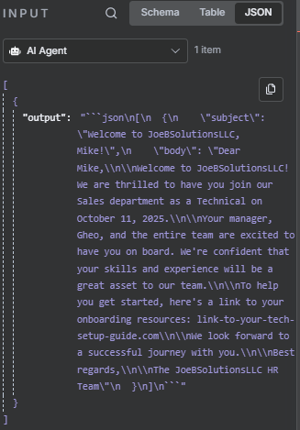
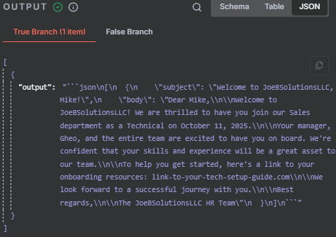
Inputs/Outputs
QC

Slide 18
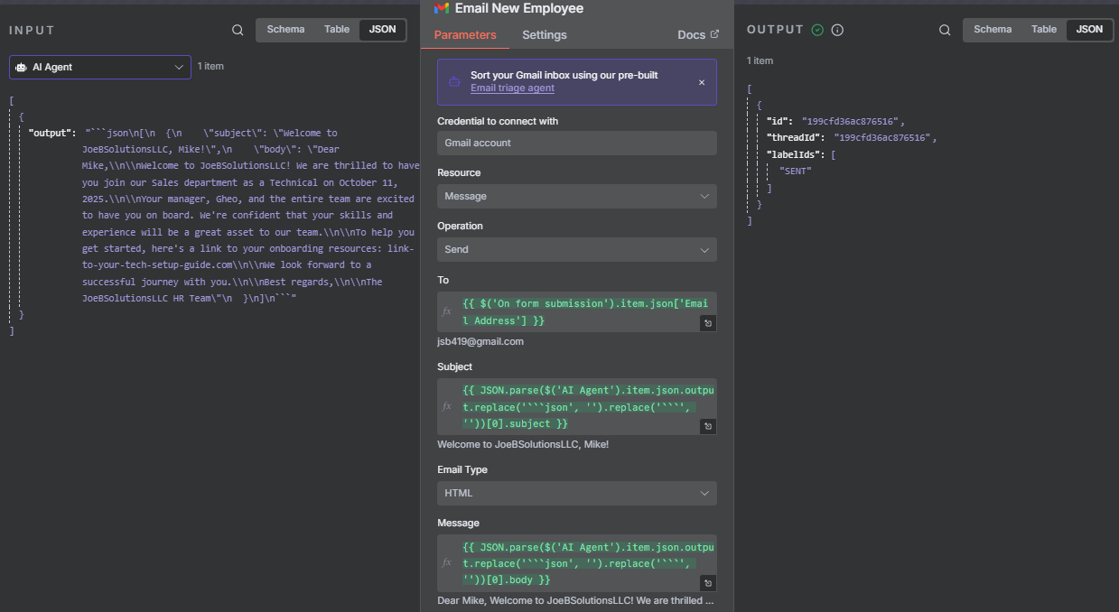
Inputs/Outputs
Email

Slide 19
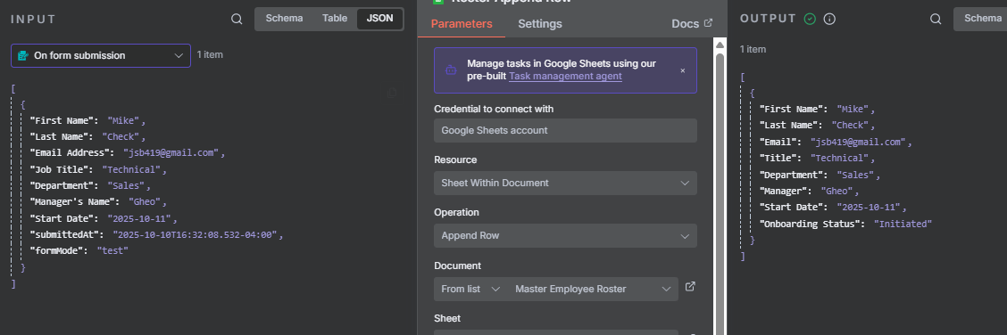
Inputs/Outputs
Append Roster

Slide 20
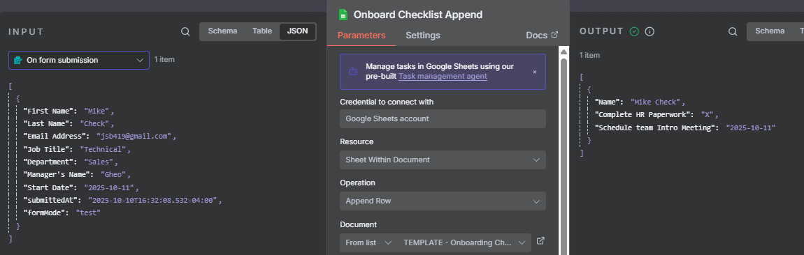
Inputs/Outputs
Append Checklist

Slide 21
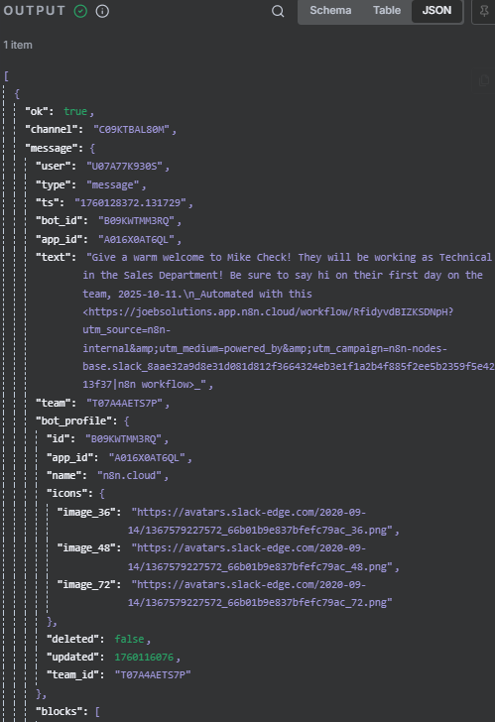
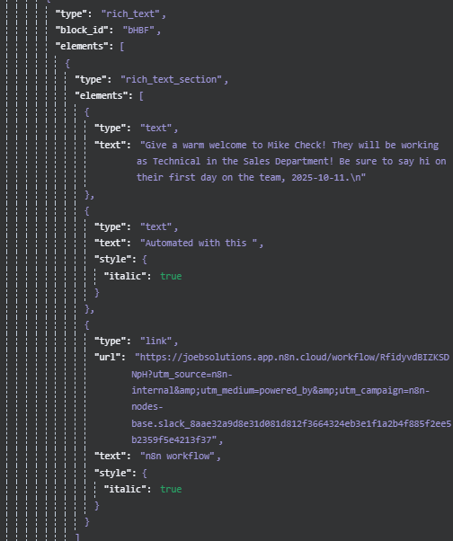
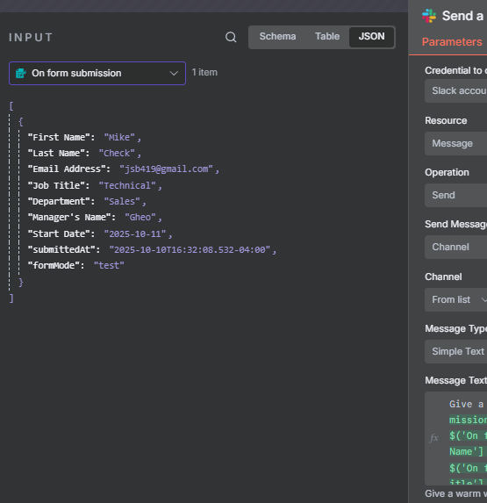
Inputs/Outputs
Slack Message

Slide 22
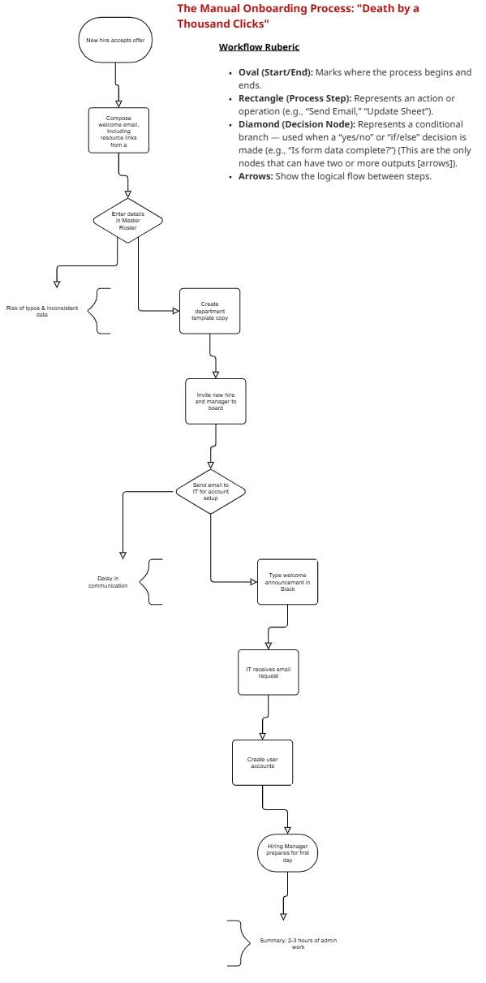
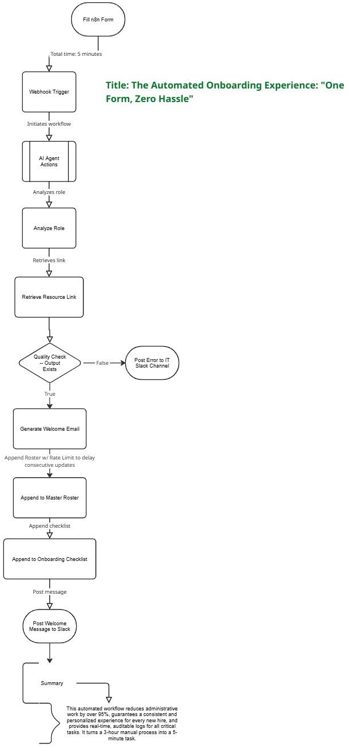
Miro Board Link
Back to Presentation

